Slide 1


NYC Arrests VS Weather Variables

Slide 2

Many factors influence crime rates in cities like New York, and weather is one potential contributor. This project investigates the relationship between weather variables and arrest rates in New York City.

Slide 3
We will explore weather data spanning from 2006 - present and analyze it alongside arrest data for NYC. Our goal is to identify any correlations between specific weather conditions (e.g., temperature, precipitation) and the number of arrests.

Slide 4

Data Sets
Statistical Analysis

Slide 5

NYPD Arrests Data (Historic)
List of every arrest in NYC going back to 2006 through the end of the previous calendar year. This is a breakdown of every arrest effected in NYC by the NYPD going back to 2006 through the end of the previous calendar year.
This data is manually extracted every quarter and reviewed by the Office of Management Analysis and Planning before being posted on the NYPD website.
Each record represents an arrest effected in NYC by the NYPD and includes information about the type of crime, the location and time of enforcement.
Notes:
The data is from opendata

Slide 6
NYPD Arrest Data (Year to Date)
List of every arrest in NYC going back to 2006 through the end of the previous This is a breakdown of every arrest effected in NYC by the NYPD during the current year.
This data is manually extracted every quarter and reviewed by the Office of Management Analysis and Planning.
Each record represents an arrest effected in NYC by the NYPD and includes information about the type of crime, the location and time of enforcement.

Slide 7
Weather Data
Visual Crossing Weather is the easiest-to-use and lowest-cost source for historical and forecast weather data.
The Weather API is designed to integrate easily into any app or code, and prices are lower than any other provider in the industry.
The data is used daily by a diverse customer-base including business analysts, data scientists, insurance professionals, energy producers, construction planners, and academics.

Slide 8
Exploratory Data Analysis
Precipitation vs daily arrests

Slide 9
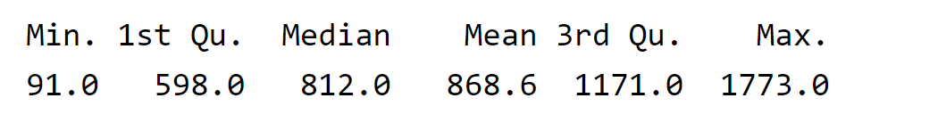
Summary of average daily arrests
Notes:
As we see on the summary of daily arrests, the average daily arrests is 869 with a minimum of 91 and a maximum of 1773.

Slide 10
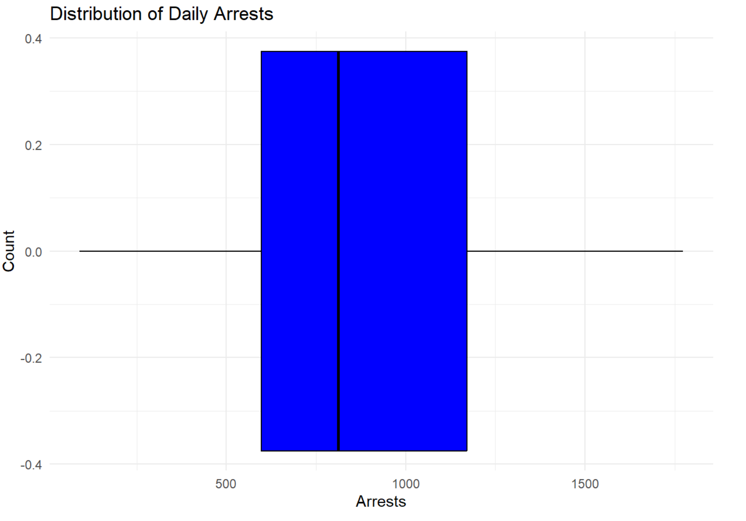
Distribution of Daily Arrests

Slide 11
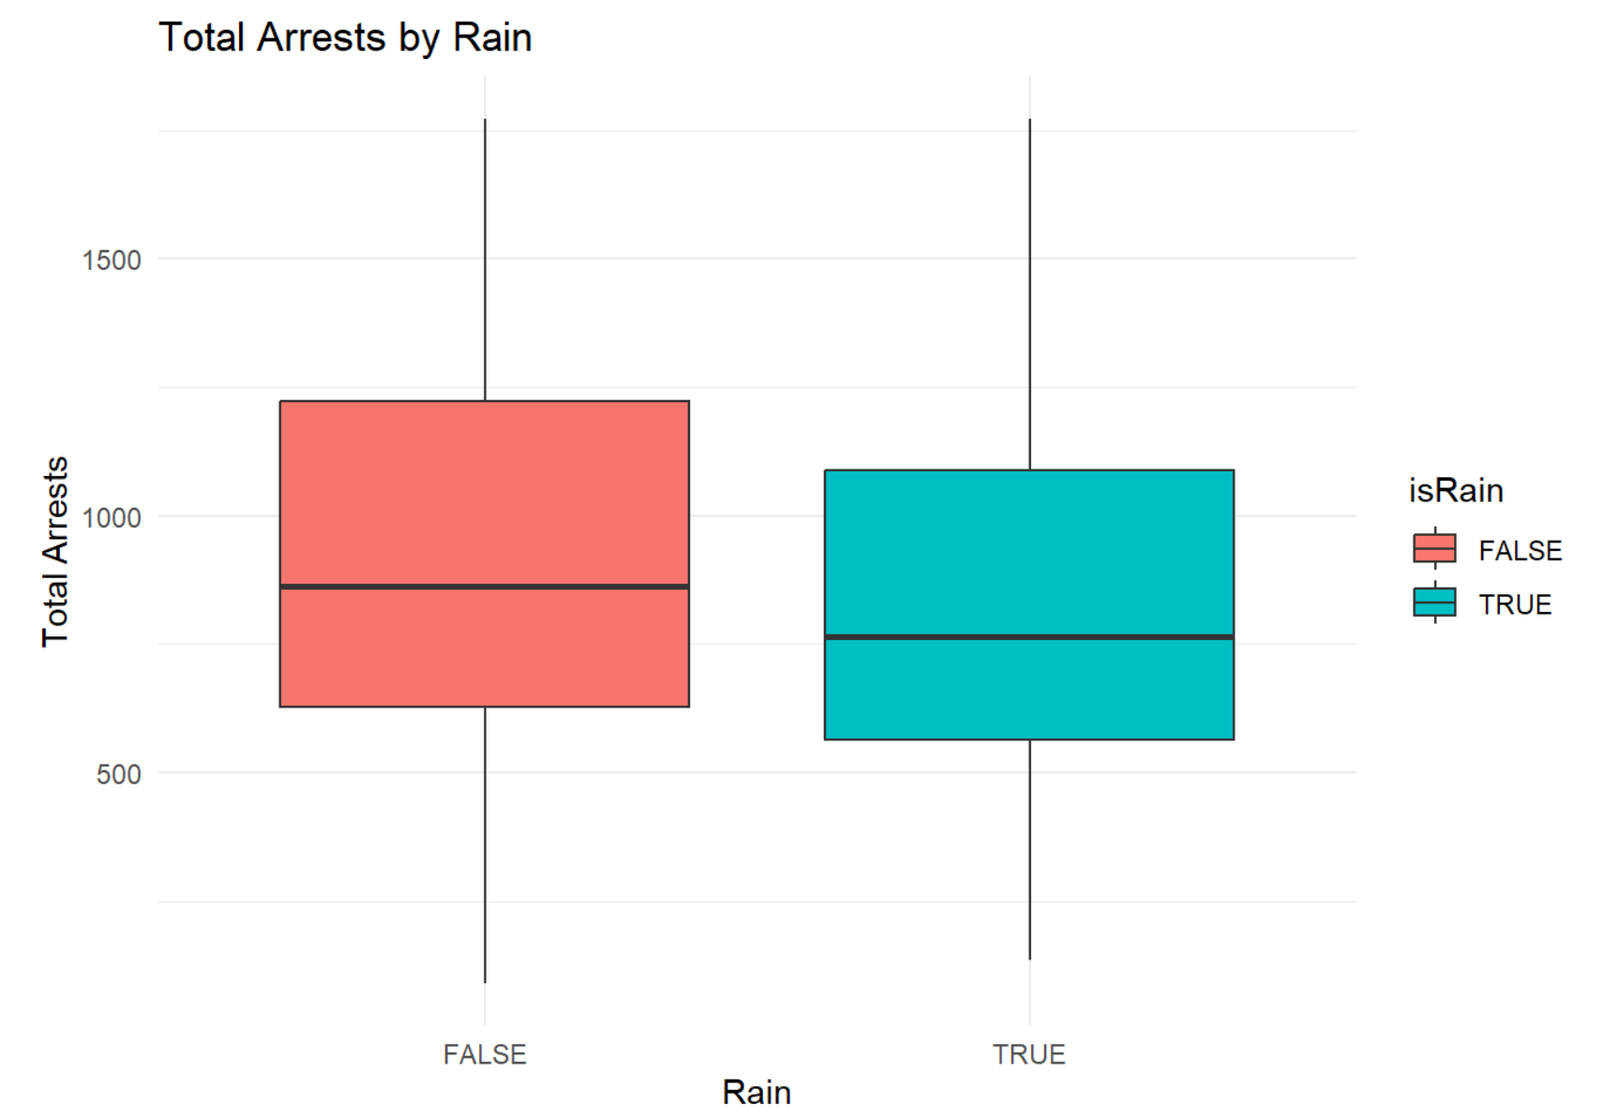
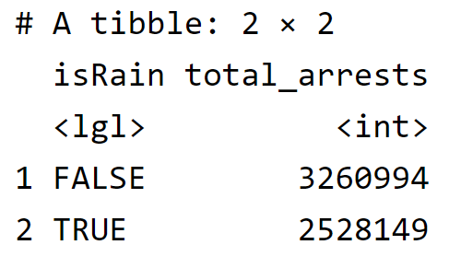
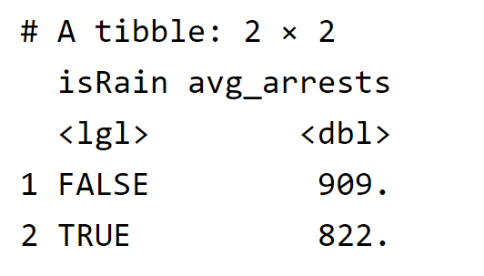
Total Arrests by Rain
Notes:
The daily arrests are higher when it does not rain than when it does.

Slide 12
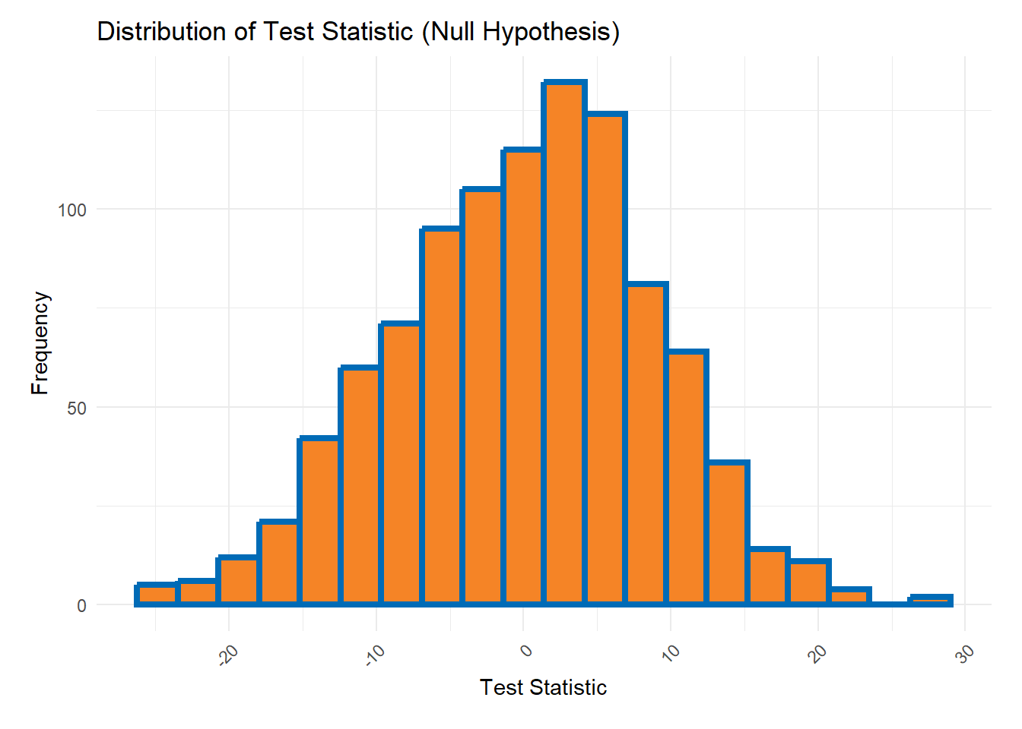
Null Hypothesis
Notes:
Null Hypothesis (H₀): There is no difference in the average daily arrests between when it rains and when it does not rain.
Alternative Hypothesis (H₁): There is a difference in the average daily arrests between when it rains and when it does not rain.
A reported p-value of almost 0 indicates extremely strong evidence against the null hypothesis. This suggests that the observed relationship between arrest rates and rain is unlikely to be due to random chance. In other words, the data provides strong evidence that rain may be associated with arrest rates.

Slide 13
Exploratory Data Analysis
Temperature Vs Daily Arrests

Slide 14
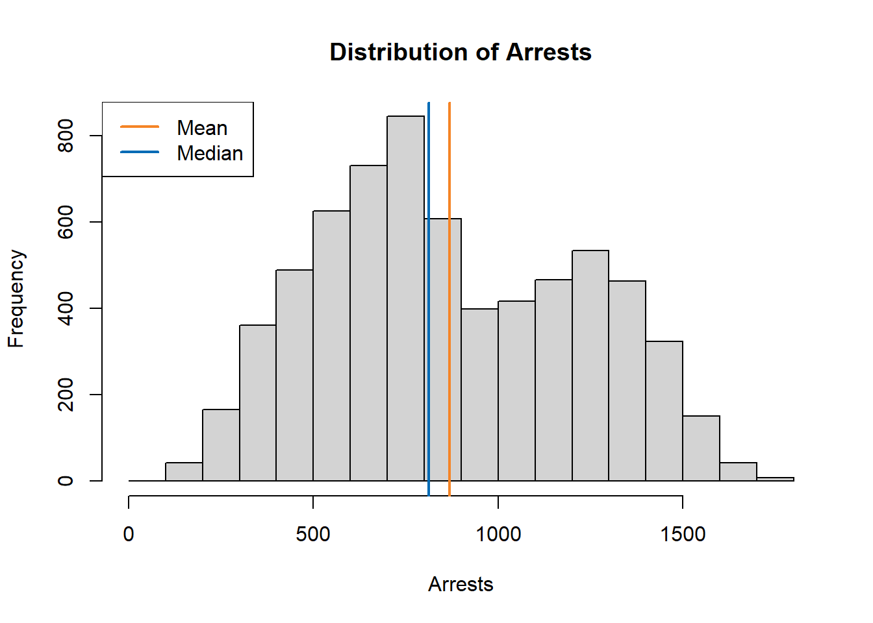
Distribution of Arrests

Slide 15
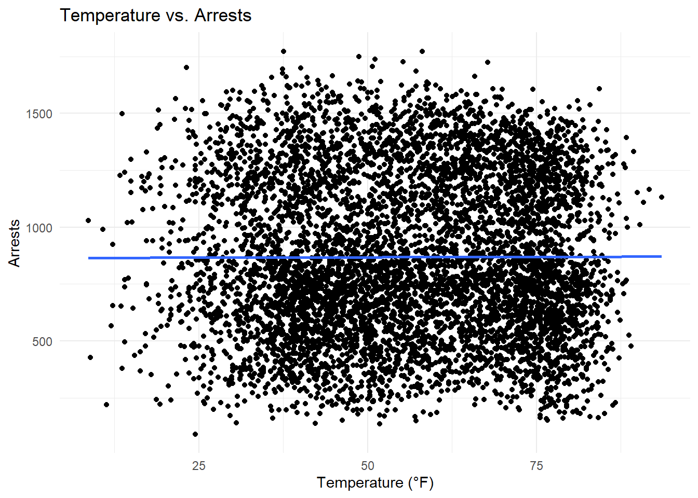
Temperature vs. Arrests
Notes:
Looking at the scatterplot we see that the concentration of arrests fall in between what one may call the “temperate” range of 40°F to 80°F. This shows that there may be a correlation between the temperature and the number of arrests. It shows a positive correlation up until the extreme temperatures.

Slide 16
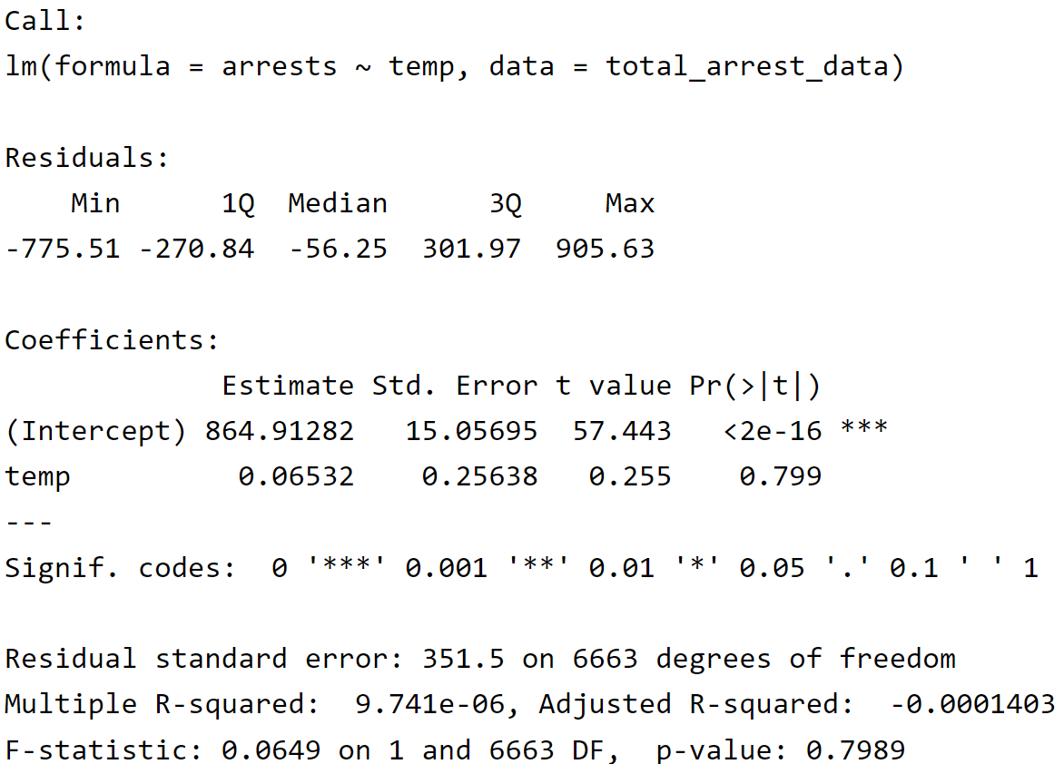
Linear Model
Notes:
Using a linear model does not show a correlation between temperature and arrests. The p-value is 0.79 which is not significant. This indicates that the temperature does not have a significant impact on the number of arrests.

Slide 17
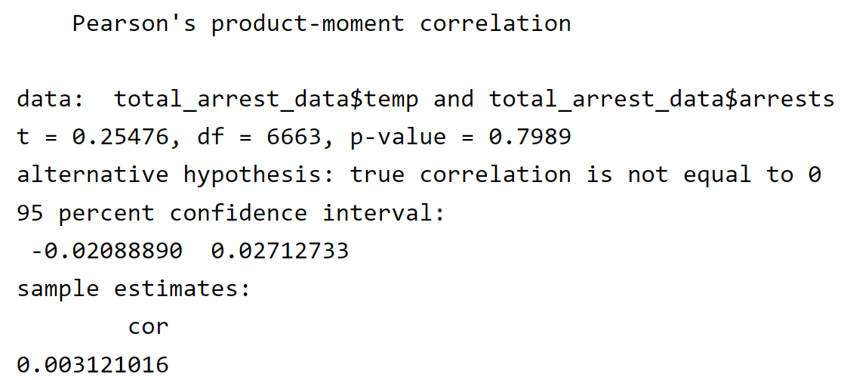
Pearson’s product-moment correlation
Notes:
We have a weak positive correlation between temperature and arrests. Indicating there isn’t a strong relationship between the two variables.

Slide 18
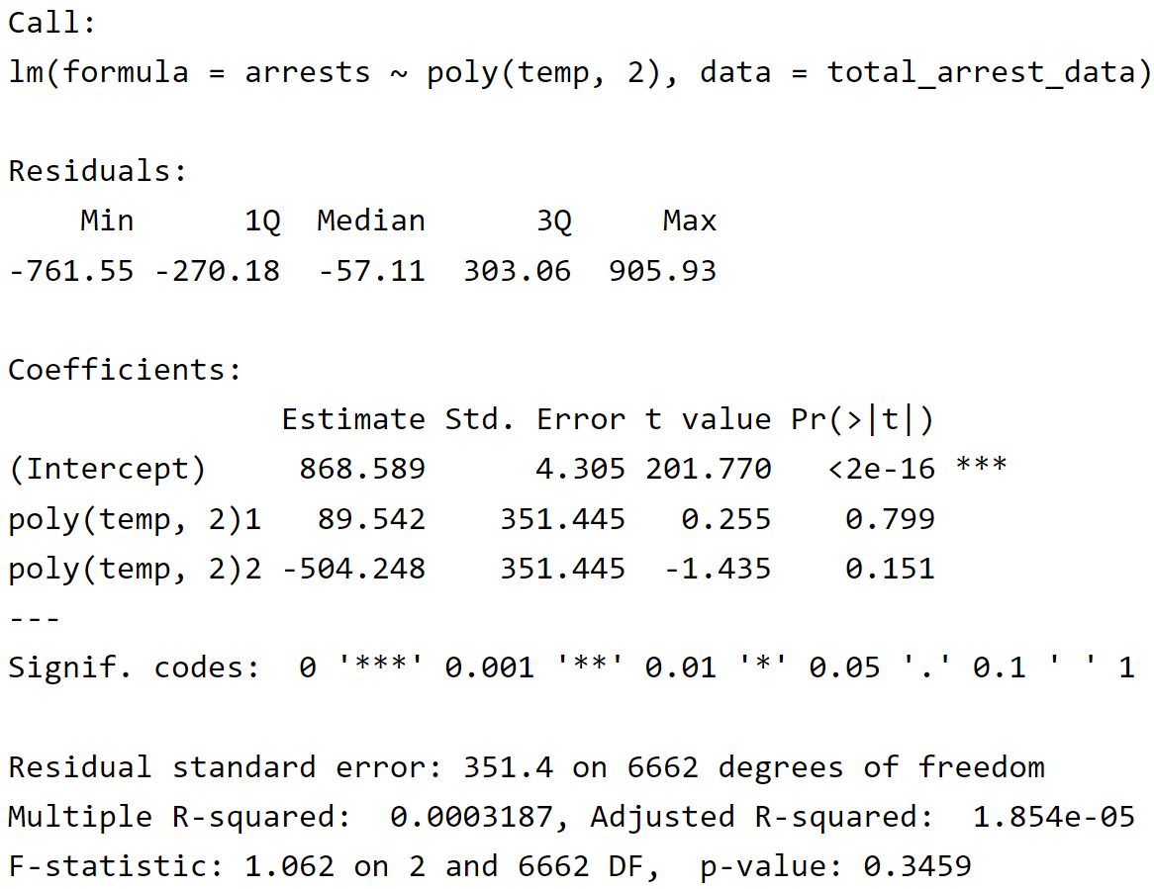
Quadratic Model
Notes:
Trying a quadratic model based on the analysis, it seems this model might not be the best fit. The p-values for both the linear (poly(temp, 2)1) and squared (poly(temp, 2)2) temperature terms are not statistically significant (above 0.05). This suggests the quadratic model doesn't capture a statistically significant relationship between temperature and arrests. The very low R-squared values (both Multiple and Adjusted) indicate the model explains very little of the variation in arrests.

Slide 19
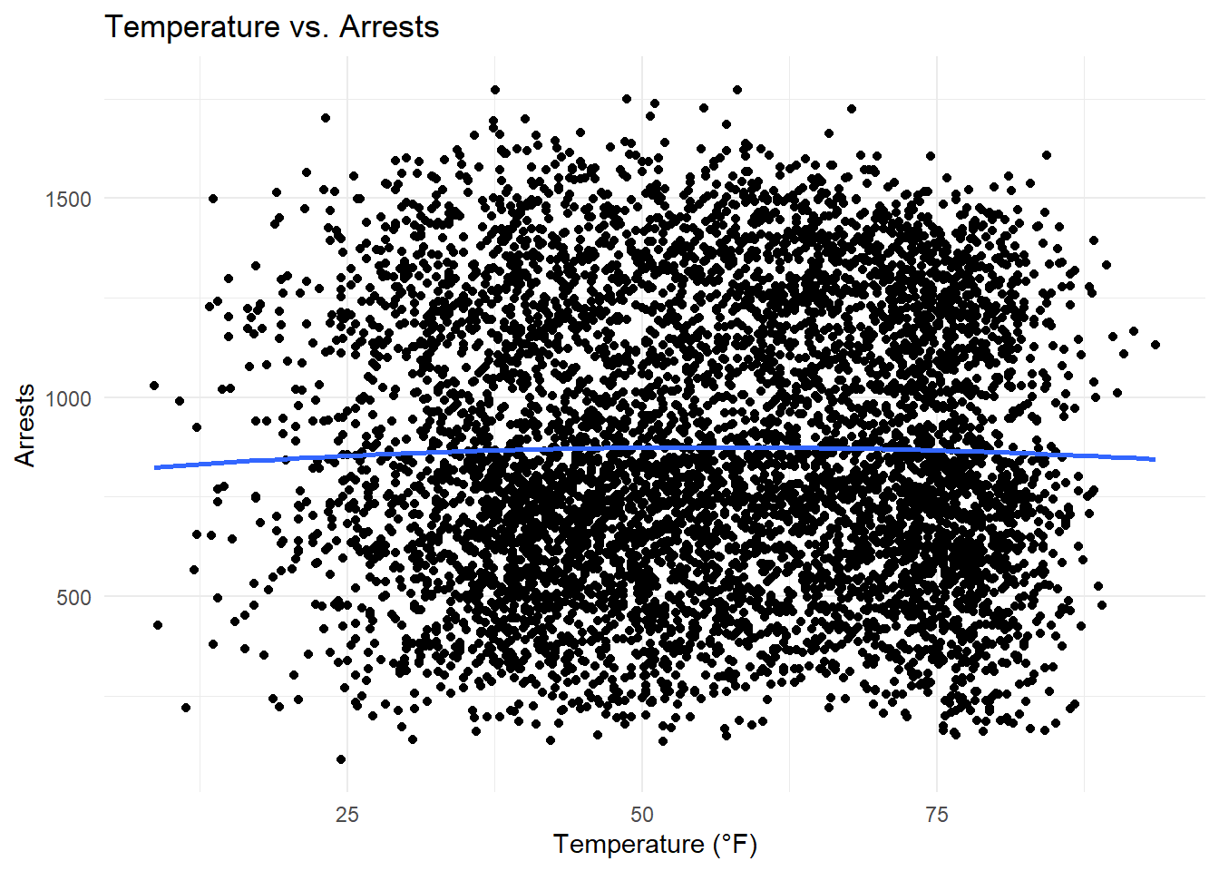
polynomial regression model
Notes:
Overall, this analysis with a separate term for the squared temperature term reaches the same conclusion as the previous model with poly(temp, 2). The quadratic term and the overall model do not capture a statistically significant relationship between temperature and arrests.

Slide 20
Conclusion

Slide 21
Conclusion
I have attempted to investigate the correlation between temperature and the number of arrests in New York City.
I have used a linear model to analyze the relationship between temperature and the number of arrests.
I also used a polynomial model to analyze the relationship between temperature and the number of arrests.
It seems that the correlation isn’t strong enough to make a significant impact on the number of arrests. The data shows that the number of arrests is higher when it does not rain than when it does. This could be due to the fact that people are more likely to stay indoors when it rains.
The data also shows that the number of arrests is higher when the temperature is between 40°F and 80°F. This could be due to the fact that people are more likely to be outside when the temperature is moderate.
Overall, the data shows that there is not a linear correlation between weather variables and the number of arrests in New York City however there is some correlation. However, there could be another model that can better show a correlation.

Slide 22
Next Steps
Data Exploration and Model Selection
Explore data visually and consider other factors that might influence arrests.
Use techniques like AIC or BIC to compare the linear vs. quadratic models and potentially more complex models (cautiously) to find the best balance of fit and complexity.

Slide 23

THANK YOU
Rashad Long
Rashad.Long66@spsmail.cuny.edu

